Slide 1
Schedule Making Project
The whole purpose of the Schedule making program is to keep up with all your upcoming Information organized. This program will take all of your information and store it and show all your upcoming events and times.
Presenter Name
Bryson Markley

Slide 2
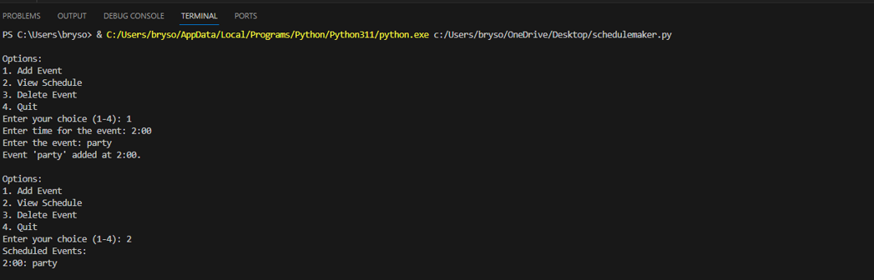
The Idea!
When we use a schedule Organizer, we typically think of a calendar to help us or use our digital phones to visually see what we have going on in the coming day. But, for this project I wanted it a py. file to able to type these events/times in for a better understanding.

Slide 3
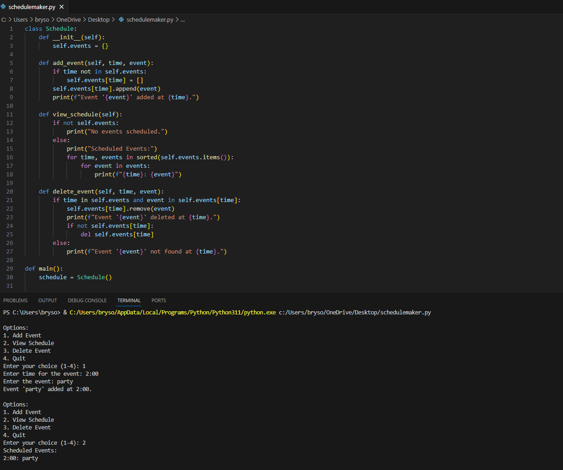
The Parts
How I made it.
How it is made.
When we run the file in the terminal our source (The code on the top helps us create the schedule). This part of the file is what is the actual work that I did to make this program.
When you break down this code are main parts are the Schedule class and a main function The two main parts are developed to take your information and store it in an organized matter.

